Slide 1
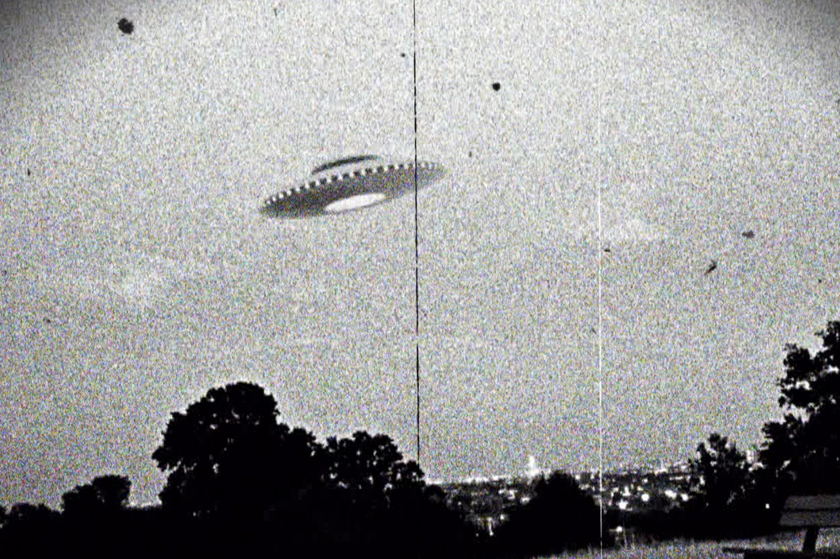
Unidentified Flying Object (UFO) SIMPLE DATA ANALYSIS
Source: National UFO Reporting Center (NUFORC)
-by Dr. TEJAS. J

Slide 2
Objectives of analysis
Descriptive analysis of data
What is the best place to sight an UFO?
What is the best time to sight an UFO?
What is best time to sight an UFO in the most common place?

Slide 3
DESCRIPTIVE STATISTICS
Description | Date & Time | City | State | Shape
unique | 51939 | 10749 | 50 | 21
Top(most frequent) | 7/4/2012 22:00 | Seattle | CA | Light
Counts | 28 | 436 | 8039 | 13344
The descriptive analysis shows that the most frequent UFO sighting occurred on 7th of April 2012 , the most frequent city being Seattle, state being California and the most common shape of the UFO was Light.

Slide 4
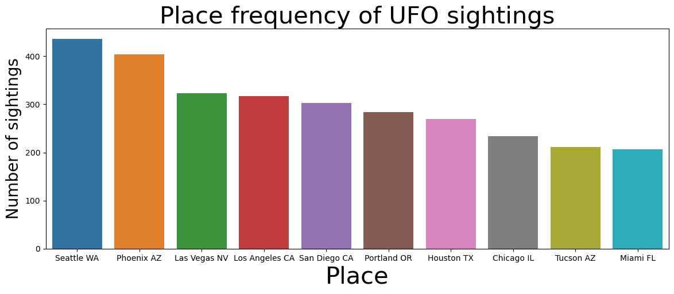
What is the best place to sight an UFO?
The best place to sight an UFO is Seattle in Washington DC as it is witnessed over 400 sightings

Slide 5
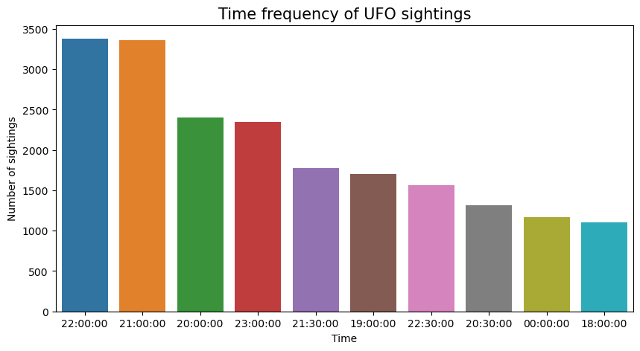
What is the best time to sight an UFO?
The best time to sight an UFO is at 22:00 hours

Slide 6
What is best time to sight an UFO in the most common place?
Within Seattle the most common shape of the UFO was Light and the most common sighting occurred at 23:15 hrs.

